Slide 1
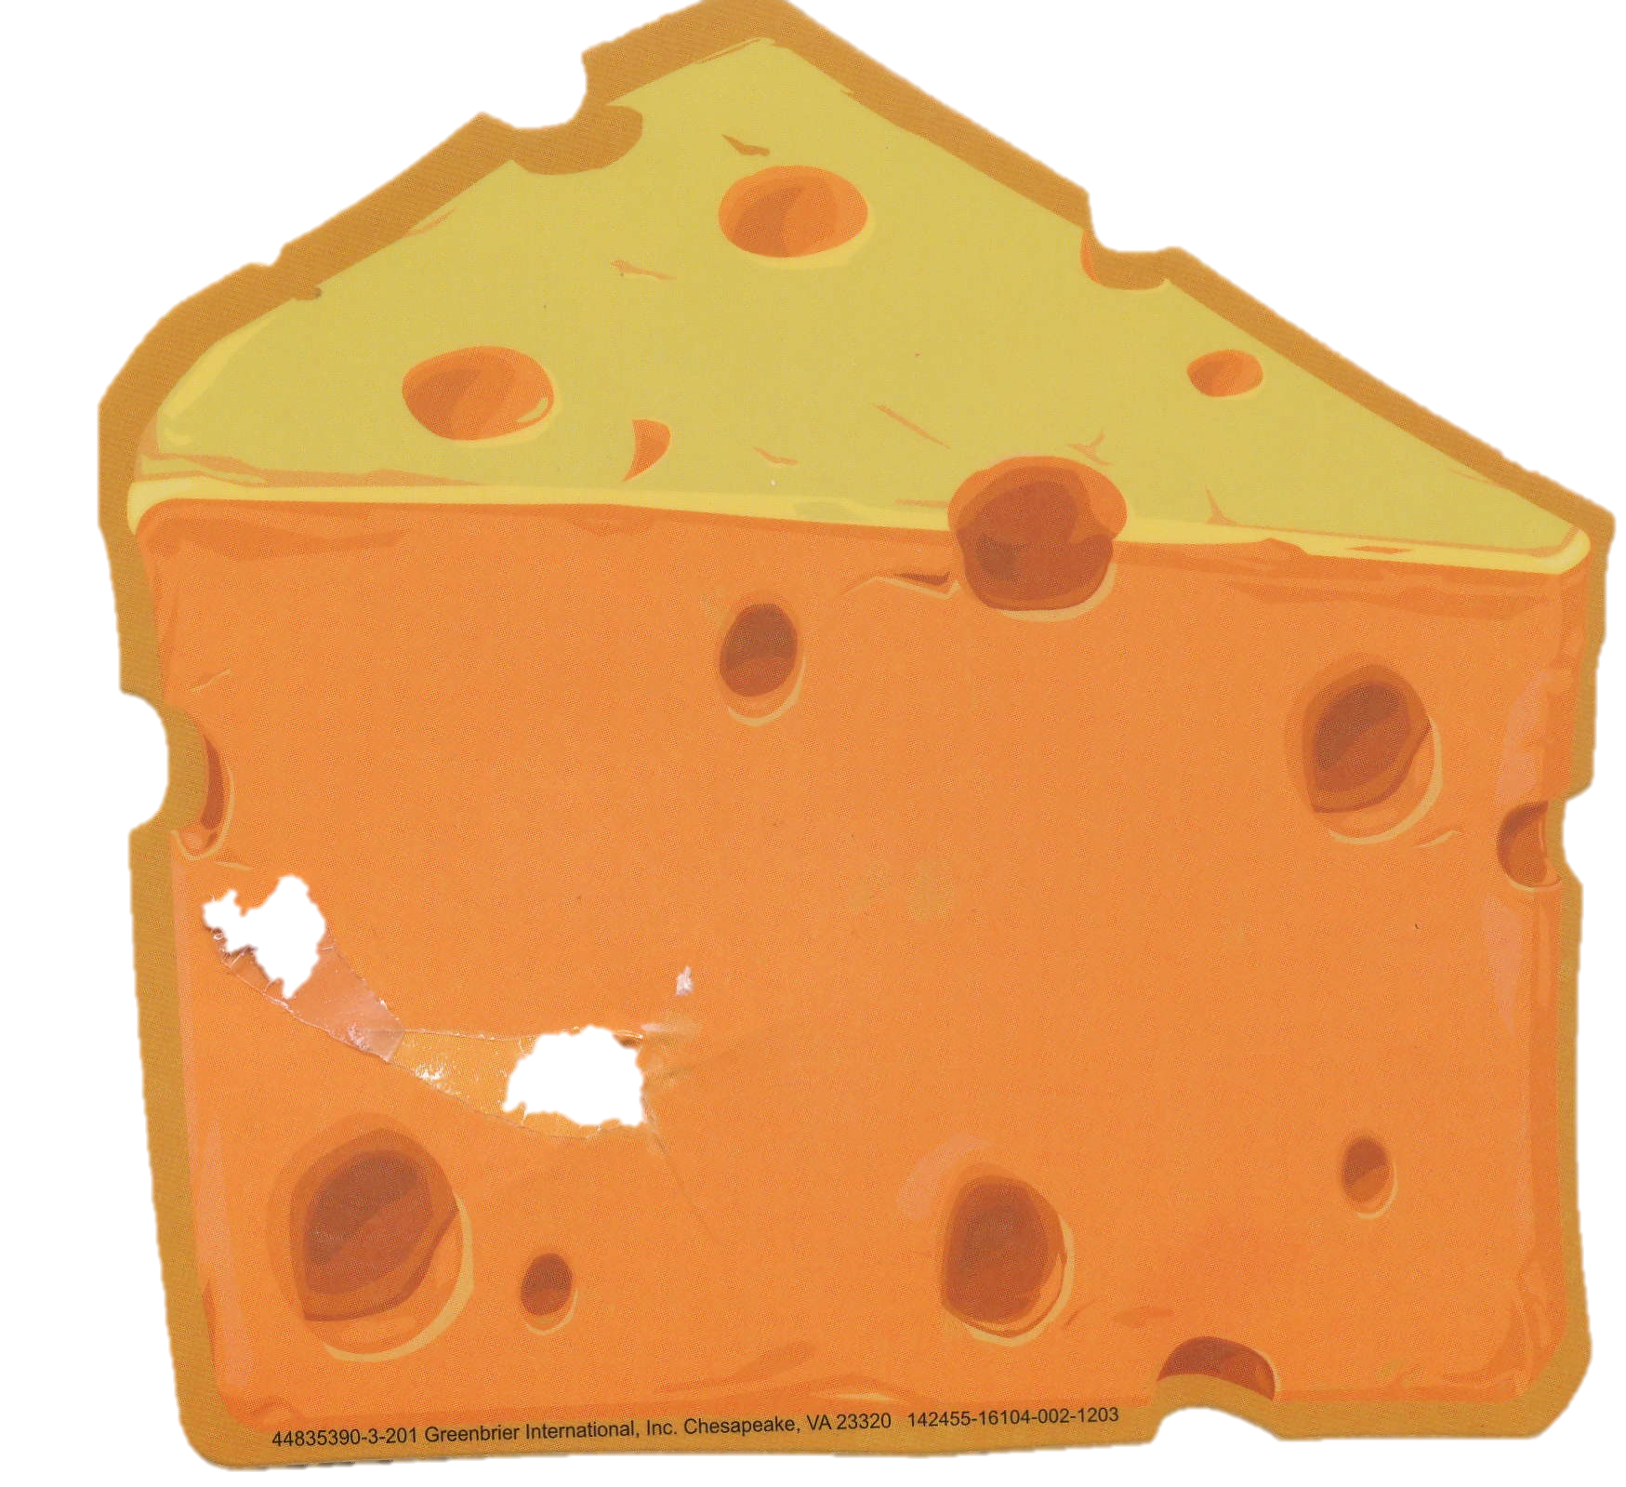
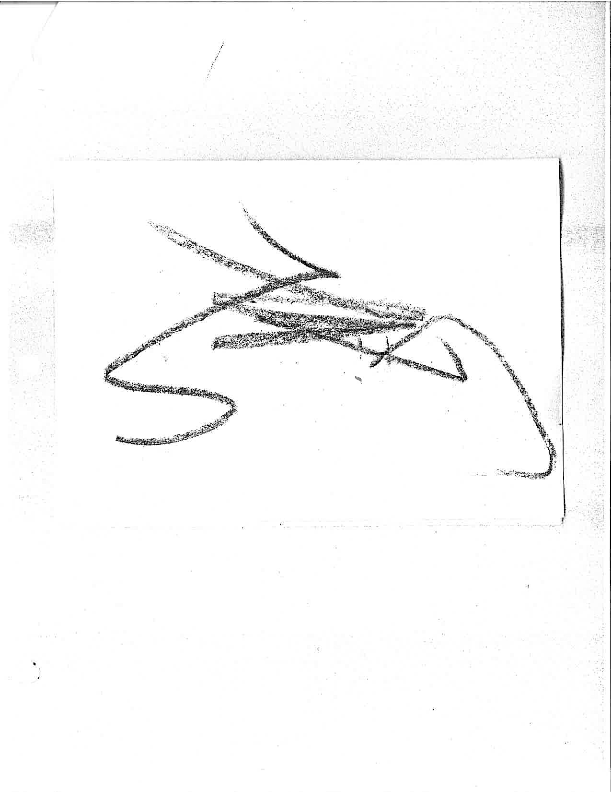
Picture Naming in Chimpanzees
Amanda Putzier, Anna Bettini, Susan Ann Keenan, & Mary Lee Jensvold
Primate Behavior & Ecology Program, Central Washington University
1.
Abstract
Method
Table 1
Category guide for coding pictures
Gardner and Gardner (1989) cross-fostered the chimpanzees, Tatu, Dar, Moja, and Washoe, as Deaf human children immersed in American Sign Language. Opportunities to look through picture books, magazines, and photos have been a part of the chimpanzees’ daily routine since early on in their lives. The items chimpanzees choose to communicate about may indicate preferences or show flexible use of signs. This study performed a content analysis on the pictorial items the chimpanzees signed about. Sign logs, an archival database, contain records of the chimpanzees’ use of signs. We selected all instances of chimpanzee signed interactions with magazines, pictures, photos, and paintings. Signed interactions included conversations between chimpanzee and caregiver as well as a chimpanzee privately signing to him or herself. A total of 161 utterances were selected for analysis. Coders categorized each item as food, clothing, beauty, vegetation, animal, or other. All of the chimpanzees signed about pictures. Tatu had the highest number of records. She signed about pictures of food more often than any other category.
Category
Description
Examples
2.
e
Sign logs are written records of the chimpanzees’ signed interactions. Caregivers completed sign logs after observing interactions or private signing. For example, if a chimpanzee signed about a picture, the observer completed a sign log .
Researchers conducted a content analysis and searched the sign log database using six keywords: magazine, picture, book, paint, newspaper, crayon, and laminate.
We reduced the selection of sign logs to specific logs describing signing about any keyword rather than logs involving keywords, but without any signs.
Two individuals coded sign logs and identified pictures according to the categories defined in Table 1.
e
e
e
3.
4.
Background
Previous studies have focused on picture recognition and picture naming in both humans and nonhuman animals [1, 2, 3, 4, 5]. Generally the picture naming process involves three stages: (1) object identification, when the physical description is retrieved; (2) activation, when the semantic features of the object are accessed; (3) response generation stage, when the picture name is retrieved and pronounced [1]. There are differences in the level of accuracy and the rapidity in naming pictures in young children, older children and adults [1]. Human babies, although lacking the ability to directly name objects, possess a high degree of discrimination between pictures and real objects as well as recognize what the photographs represent [2]. This ability develops gradually as young children mature and eventually reaches the same level as adults. In studies related to nonhuman animals, researchers consider that a picture is recognized when animals react to the picture as they would in the presence of the real object [1]. Marmosets and monkeys have several reactions to still pictures, such as grabbing when faced with pictures representing several prey, and fear reactions when faced with a picture of a cobra or snake [3, 4, 6]. Hamadryas baboons recognize and identify still pictures of conspecifics [5]. For further review on this subject see Bovet and Vauclair (2000) [6].
5.
Figure 1. Percentage of picture categories that elicited signs.
The ‘Other’ category was further broken down to indicate that 6% of Tatu’s utterances were about magazine elements and that 3% of Tatu’s and 25% of Dar’s utterances were about artwork.
Interrater Reliability
Tatu (129 Utterances) - 83%
Dar (20 Utterances) - 100%
Moja (10 Utterances) - 60%
Washoe (2 Utterances) - 100%
Conclusions
Picture Naming Examples
e Chimpanzees recognized and signed about items in their daily environment and items not typically present.
e Tatu incorporated other behaviors, interacting with pictures, which occurs in other nonhuman animals and in children during imaginary play.
e Examination of the pictures the chimpanzees choose to sign about appears to be a promising method of analyzing their potential preferences and interests.
e With a wider spread of logs, a content analysis could determine if there are developmental differences in the items the chimpanzees signed about.
1.
I (SG) was on the berm and looked through a magazine with TA. I came to a picture of a couple kissing. I pointed to the picture and signed THAT XR KISS 1B/1. I looked at TA and she was looking intently at the picture, so I again signed THAT XR KISS 1B/1. TA then pushed her lips through the cage as if offering a kiss. I then began to move the magazine closer to her face and she pressed her lips even further out of the caging. I then thought that she may want to kiss the picture so I put the magazine right up by her face. TA then proceeded to give the magazine a big long kiss right on the picture of the kissing couple.
3.
8/10/05
TA was sitting up on the ledge outside and flipping through a magazine.
TA: THAT 1L BLACK XL/1 pointing on one black letter.
TA: THAT XL BLACK XL/1 pointing on different letter on the magazine. … She kept flipping the magazine. … Then TA flipped pages back to page 3
TA: THAT XL BLACK XL/1 pointed on different black letters
TA: THAT XL BLACK XL/1, again by pointing on different black letters on page 3. She seemed to be fascinated by those letters.
3/2/05
2.
Last weekend I (MM) found some giant paper yellow cheese blocks. I laminated a bunch of them and wanted to show TA. I put all the laminated cheese in front of cage 4 and asked TA.
MM: WHAT THAT?/
TA: CHEESE XR/1 (signed twice)
MM: RIGHT! THAT CHEESE/ YOU LIKE CHEESE?/
TA: GIMME 1L/1
MM: slides TA one of the laminates. TA picked it up and smelled it, then she put it down in front of her
TA: THAT 1L CHEESE 1R/1
Then she picked it up and bit into it!
2/21/13
4.
MLJ holds chimp picture and asks DAR WHAT THAT?/. DAR signs something in front of lips, perhaps bird, but MLJ can’t see what it is. She asks DAR again WHAT THAT?/. DAR signs DOG XL CHASE 1L/1 and moves away.
Subjects
12/31/02
References:
[1] Cycowicz, Y. M., Friedman, D., Rothstein, M., & Snodgrass, J. G. (1997). Picture naming by young children: Norms for name agreement, familiarity, and visual complexity. Journal of experimental child psychology, 65(2), 171-237.
[2] Rose, S. A., Gottfried, A. W., & Bridger, W. H. (1983). Infants' cross-modal transfer from solid objects to their graphic representations. Child Development (48), 1086-1091.
[3] Kyes, R. C., Mayer, K. E., & Bunnell, B. N. (1992). Perception of stimuli presented as photographic slides in cynomolgus macaques (Macaca fascicularis). Primates, 33(3), 407-412.
[4] Rosenfeld, S. A., & Van Hoesen, G. W. (1979). Face recognition in the rhesus monkey. Neuropsychologia, 17(5), 503-509.
[5] Kyes, R. C., & Candland, D. K. (1987). Baboon (Papio hamadryas) visual preferences for regions of the face. Journal of Comparative Psychology, 101(4), 345.
[6] Bovet, D., & Vauclair, J. (2000). Picture recognition in animals and humans. Behavioural brain research, 109(2), 143-165.
5.
I (SS) gave TA a magazine so she could have a little reading while she enjoys the sun. TA sat up on the ledge and started to flip through the magazine. … She kept flipping pages. …
TA: THAT IR (pointing on the dark Thermasilk bottle #16) BLACK XR/1
SS: THAT BLACK ?/1 oriented towards TA. TA didn’t respond to me. Later...
TA: THAT XR (pointing on the dark Thermasilk bottle again) BLACK 1R/1
TA: THAT XR (pointing on the #13 [makeup] product) BLACK 1R/1.
Four cross-fostered chimpanzees, Washoe, Moja, Dar, and Tatu, acquired signs from American Sign Language. While living at the Chimpanzee and Human Communication Institute, they continued to sign and expand their vocabularies by interacting with each other and human caregivers. A variety of enrichment was available to the chimpanzees to communicate about, including costumes, toys, clothing, magazines, puzzles, paint, and pictures.
Transcript Key
3/17/05
1 = frequency of a sign or utterance
X = a sign was reiterated
R/L/B = the active hand in the sign
/ = the end of an utterance
Capital letters = name of caregiver/chimpanzee and English word meanings of ASL signs
* Please note that utterances are transcribed word-for-word.

