Slide 1
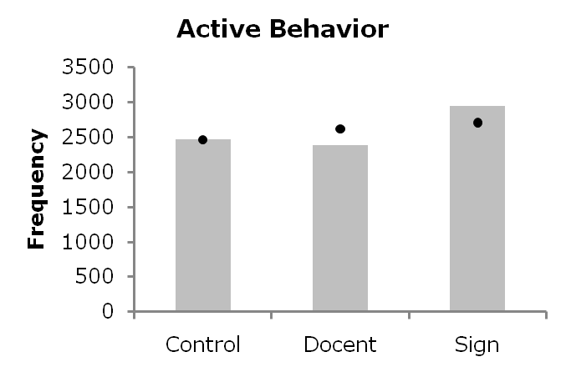
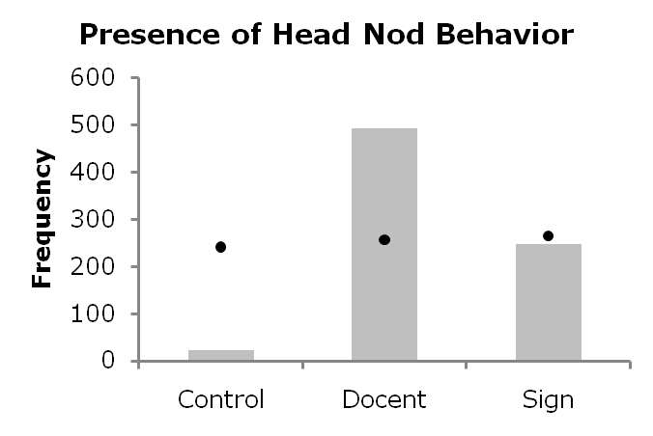
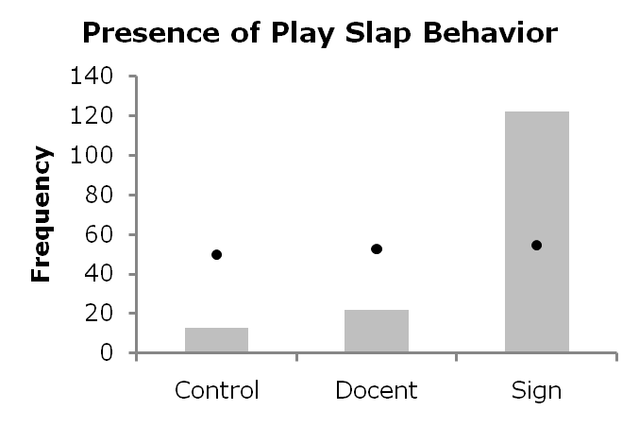
Exploring Visitor Behavior at a Florida Zoo
Jessica M. Mas, Amanda L. Carner, Kaeley Sullins, Mary Lee Jensvold, & Lindsay Zager
The Chimpanzee and Human Communication Institute
Introduction
Chimpanzee Results
Apes are highly social and their relationships with conspecifics are critical to their survival and well-being (i.e. dominance hierarchy, learning local culture, and tool use).
Relationships are manifested in rich means of communication, such as facial expressions, postures, and gestures.
Humans very often become part of the captive apes’ social environment. This is described as Human-Animal Relationships or HAR (Hosey 2008). These relationships come in two forms:
Caregivers (familiars)
Visitors (strangers)
Apes are the most popular of all zoo residents (Gold and Benveniste, 1995). However, much research shows visitors are a potential source for stress (Davey, 2007; Hosey, 2000). This is particularly true for social species like apes.
The stress is related to a variety of factors including crowd size (Todd, Macdonald, & Coleman, 2006; Kuhar, Smith, & Soltis, 2008; Glatston, Geilvoet-Soeteman, Hora-Pecek, & van Hooff, 1984; Jones & Wehnelt, 2003 for review), location (Mitchell, et al. 1990), noise (Birke, 2002), and visitor behavior (Hosey & Druck, 1987; Mitchell, Tromborg, Kaufman, Bargabs, Simoni, & Geissler, 1992).
Aggression toward the visitors is one behavioral pattern that is manifested in the presence of visitors (Mitchell, Herring, Tromborg, Dowd, Steiner, & Obradovich, 1992; Mitchell, Obradovich, Herring, Dowd, & Tromborg, 1991).
Zoo visitors want to interact (Kreger & Mench, 1995; Wood, 1998) and sometimes unknowingly engage in threatening behaviors (Mitchell, Herring, & Obradovich, 1992). Human visitors sometimes imitate the behaviors they see, such as vocalizations (Cook & Hosey, 1995) and hostile behaviors (Nimon & Dalziel, 1992).
The apes respond to this and it escalates the interaction, causing heightened aggression and increased stress.
The goal of this study was to promote chimpanzee friendly behavior to promote a more positive experience for zoo visitors as well as zoo residents.
Vistor Results
Figure 4. Chimpanzee activity level
Figure 1. Visitor Activity Level
SR = 4.48
Figure 4 illustrates that the chimpanzees were most active during the docent condition.
= p <.001
Discussion & Conclusion
Figure 1 illustrates the expected and observed frequencies of intervals containing active and passive behaviors, respectively. The circles represent the expected frequencies of active and passive behavior. The top portion of the bars illustrates the observed frequencies. Stars indicate statistical significance.
Visitors were significantly more active in the sign condition than would be expected given the null hypothesis, SR = 4.48, p = <.001. Visitors were significantly less active in the docent condition than would be expected given the null hypothesis, SR = -4.51, p = <.001.
This study shows we can change the behavior of zoo visitors by educating them on appropriate chimpanzee behaviors and how to use them. This study also shows that the use of chimpanzee behaviors promotes a more activity in chimpanzees.
This type of visitor education and use of species-specific behaviors can provide a means in interact with the chimpanzees in a positive way. This in turn effects the behavior of chimpanzees.
The graphic sign and docent presence can be considered effective manipulations because their implementation resulted in behavioral changes that were emphasized in each condition.
The use of the head nod and play slap by zoo visitors may also serve to increase friendly interactions between human visitors and chimpanzee residents.
The use of friendly behaviors by zoo visitors can serve to mediate any stress to nonhuman residents, promoting the welfare mission of the zoo.
Changed visitor behavior can result in positive behavioral changes in captive nonhuman primates. Caregivers’ use of friendly behaviors decreased aggression and increased affiliation in a captive chimpanzee population (Jensvold, 2008), suggesting that humans’ use of friendly chimpanzee behaviors does impact chimpanzee behavior.
Ultimately, captive zoo animals serve as a means for visitors to connect with the natural world (Rabb & Saunders, 2005). In the current climate of endangered species, habitat loss, and destruction of natural resources, zoos must now shift from institutions promoting environmental knowledge to institutions facilitating positive relationships between humans and nature (Ogden & Heimlich, 2009; Vining, 2003). In this regard, interactive educational programs which emphasize the use of species-specific, friendly behavior by zoo visitors can be a powerful tool to fulfill both the educational and conservational missions of the modern zoo.
Methods
Figure 2. & Figure 3. Visitor’s Use of Chimpanzee Behaviors
Two cameras recorded the behavior of zoo visitors on a viewing platform beside a 2-acre chimpanzee island at the Zoo of Northwest Florida.
In the sign condition, a sign was placed on the viewing platform with descriptions and graphics of friendly chimpanzee behaviors, such as head nods and play faces.
In the docent condition (no sign), a docent encouraged visitors to use head nods, and provided visitors with general chimpanzee facts.
In the control condition there was no sign or docent
= p <.001
= p <.001
Figures 2 and 3 illustrate the expected and observed frequencies of the head nod and play slap behaviors as they varied by experimental condition. The circles represent the expected frequencies of each behavior. Stars indicate statistical significance.
Visitors were more likely to play-slap in the sign condition than would be expected by chance (SR = 9.13, p < .001)
Visitors were more likely to head nod in the docent condition than would be expected by chance (SR = 14.81, p <.001)

